Slide 1
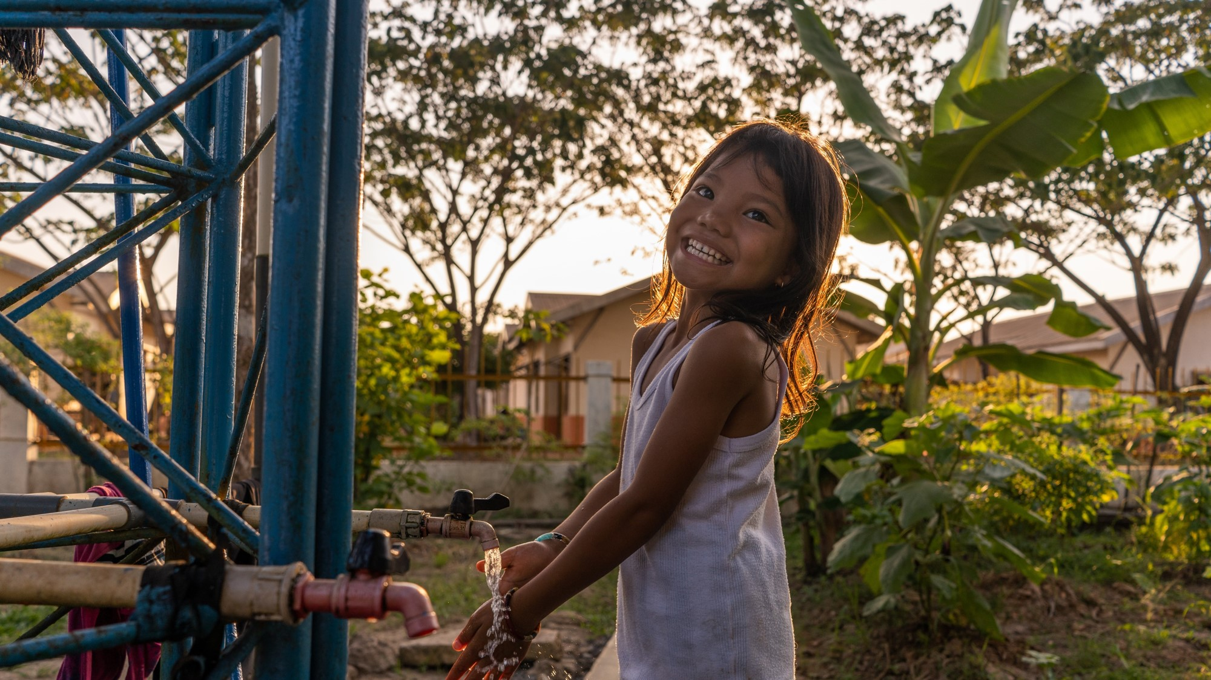
Maya Faisal, Chief of Social Policy
UNICEF Philippines
SEC-PSE Corporate Governance Forum
24 November 2023
Children’s Rights and Business:
Its Role in Corporate Governance

Slide 2
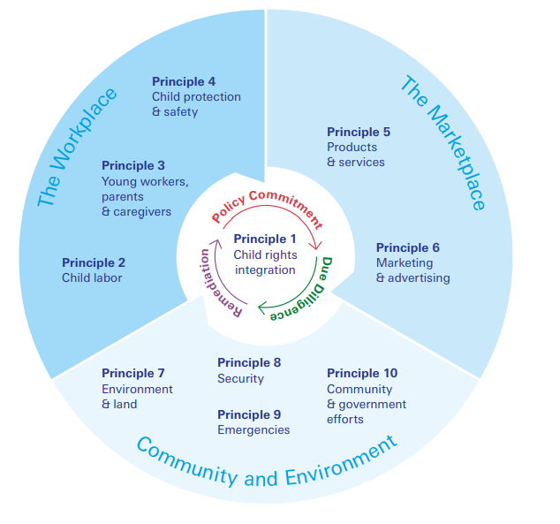
Women’s economic empowerment
Good internet governance
The impact businesses have on children goes beyond child labor
Family Friendly Policies
Responsible marketing & advertising
Community relations
Climate resilience
Notes:
CRBP
Links to other sustainability issues

Slide 3
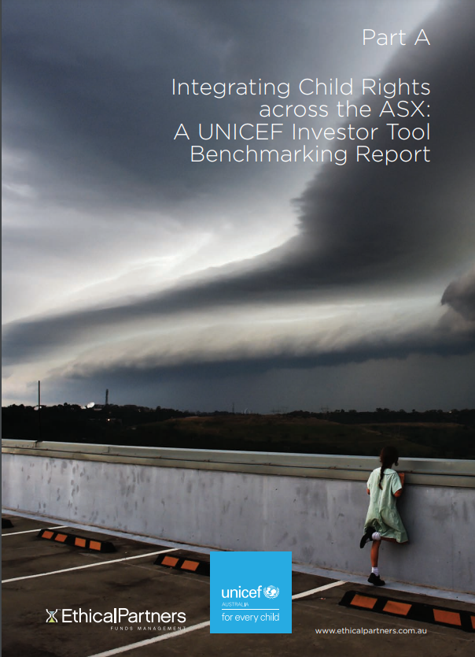
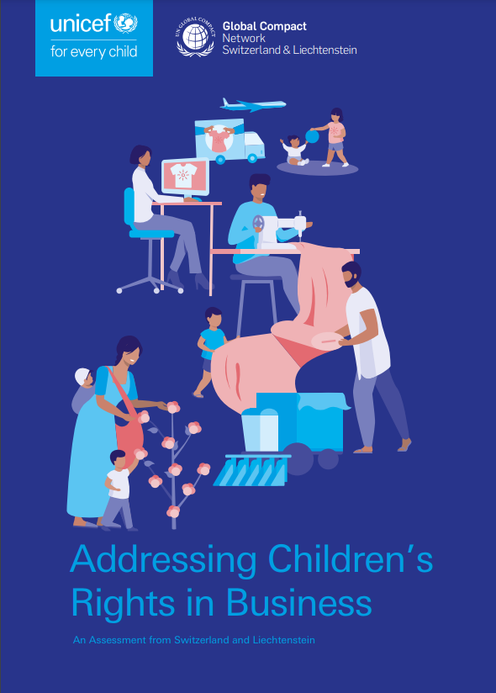
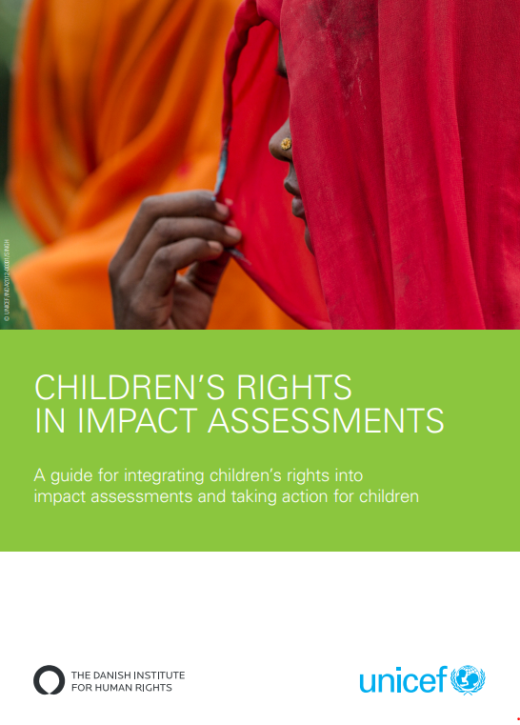
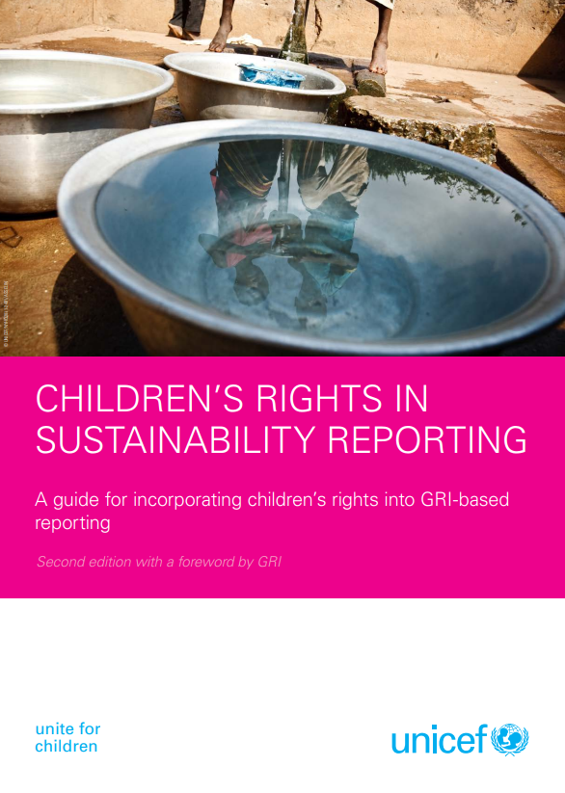
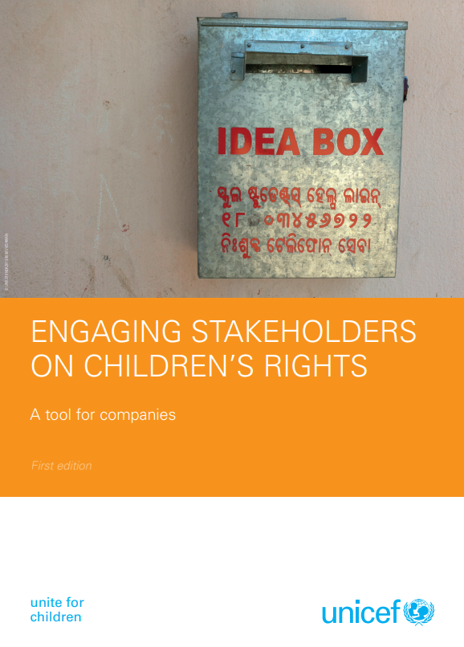
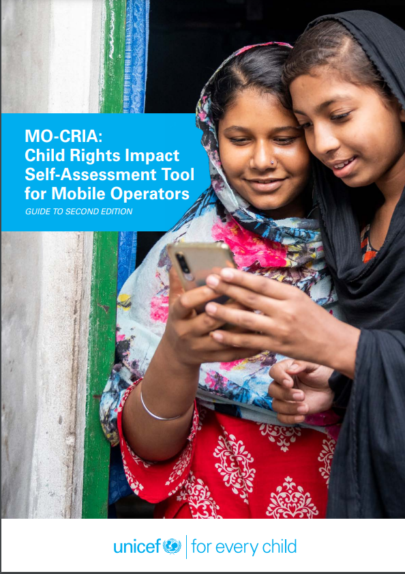
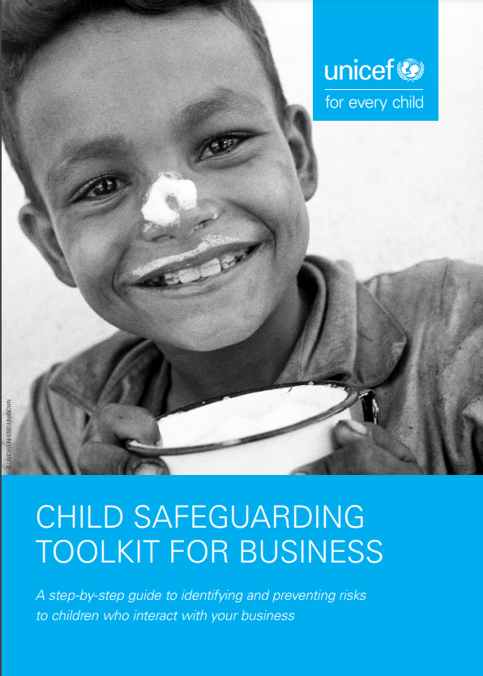
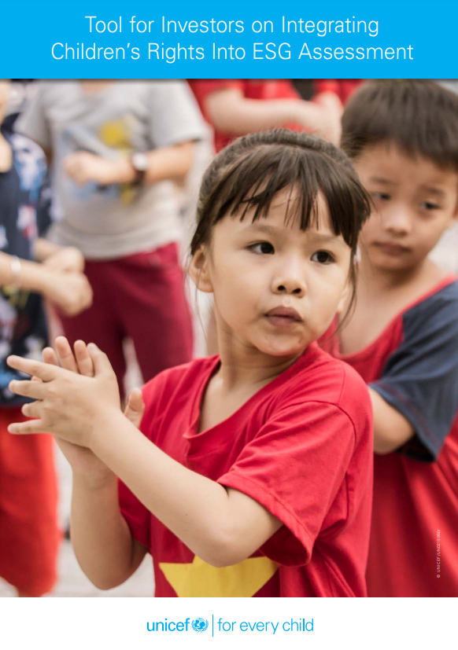
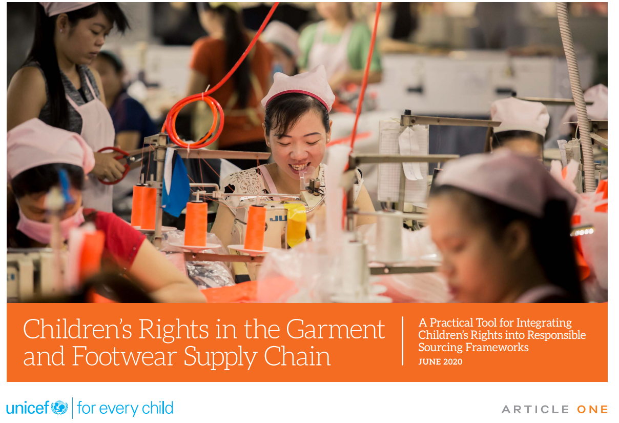
“Respecting and supporting children’s rights requires business to both prevent harm and actively safeguard children’s interests.”
Children’s Rights and Business Principles
© UNICEF/PHOTO CREDIT
Notes:
Assessing child rights performance of companies
Clearly communicating expectations
Pushing for impact assessment and improved disclosure
Collaborating on improved policy and practices
Supporting capacity building
Engaging with Stock Exchanges

Slide 4
Resources
Children’s Rights and Business Principles
Tool on Children’s Rights in ESG Assessments
Children’s Rights in Garment and Footwear supply chains
Integrating Child Rights Across the ASX
Children’s Rights and Business Main Page
Child Lens Investing Framework
© UNICEF/PHOTO CREDIT

