Slide 1
Lauren Wetherilt Global Living Wage Project Manager Living Wage Foundation

Slide 2
Title Name Position Living Wage Foundation
Our Living Wage movement has…
Has over 14,000 accredited Living Wage Employers
Lifted over 460,000 workers onto the real Living Wage
Put £3bn back into the pockets of low paid workers.

Slide 3
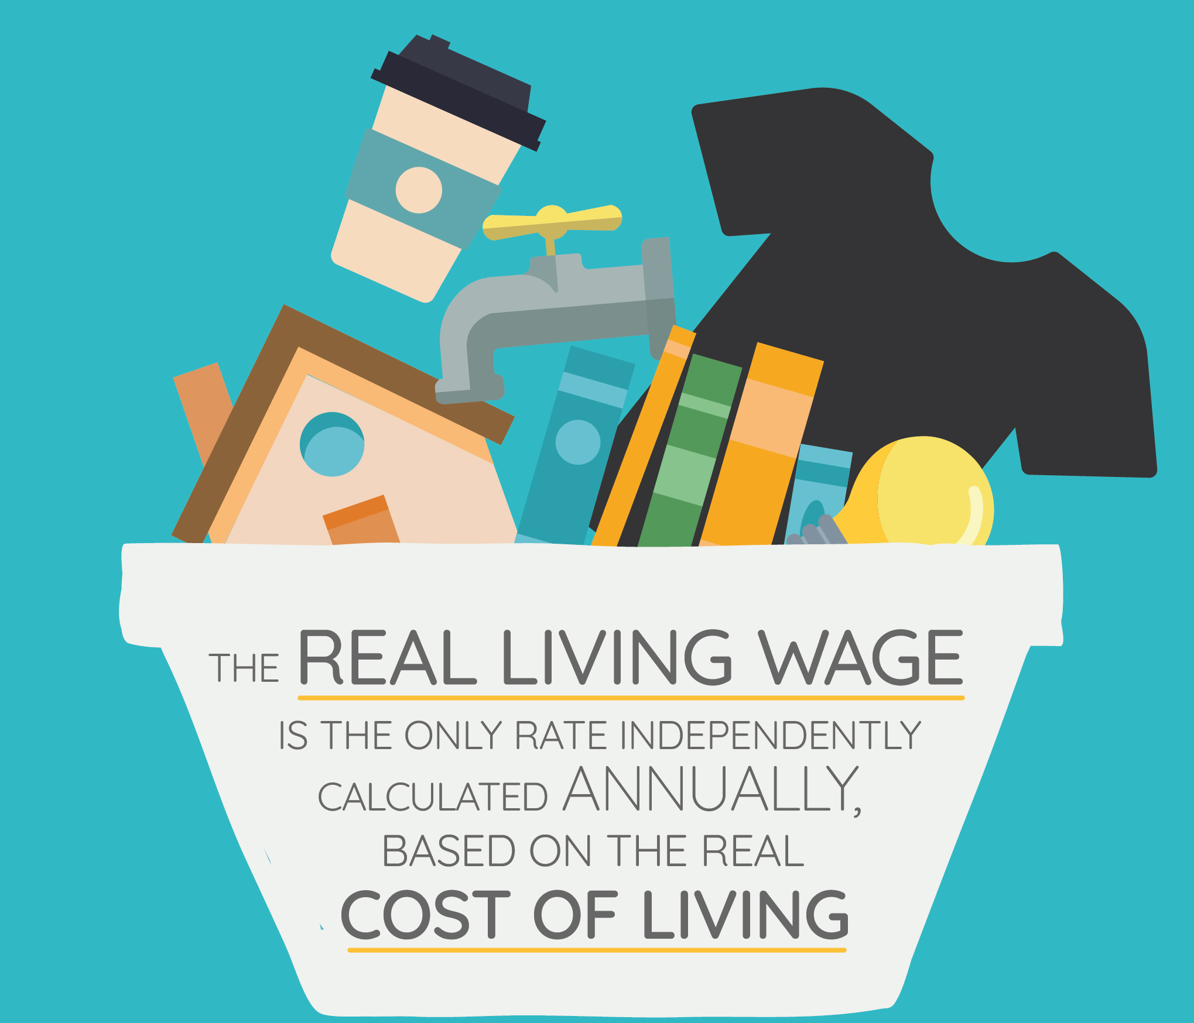

Slide 4
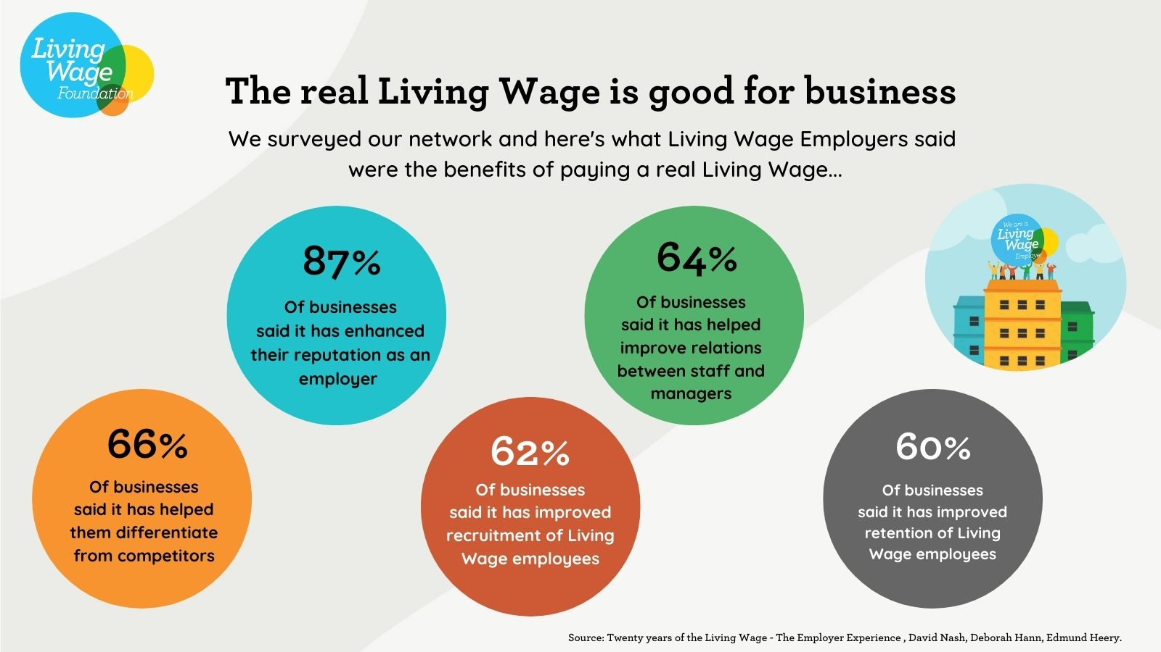
The Living Wage is good for business

Slide 5
Going beyond the Living Wage
Millions of low paid workers also struggle to get the hours they need to make ends meet – this scheme provides security of hours alongside a real Living Wage
We have just launched a Living Pension standard for retirement savings that will provide enough for an acceptable standard of living beyond working life

